Slide 1
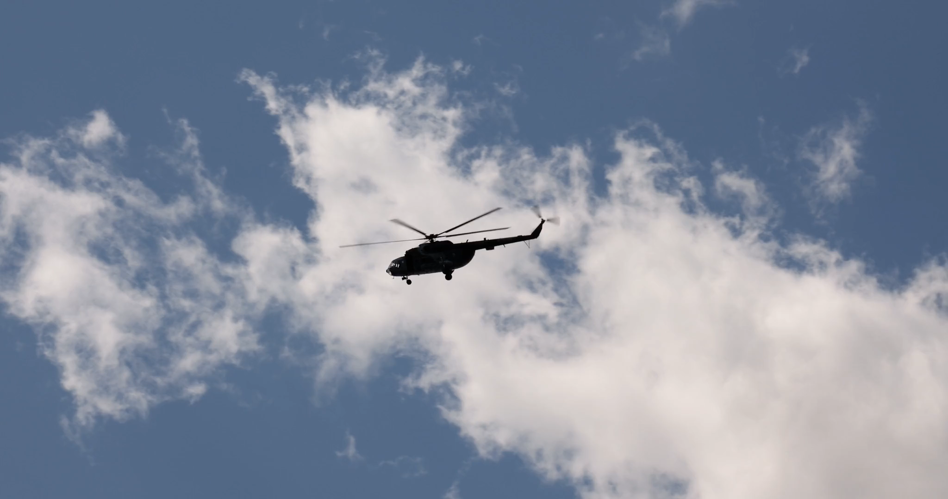
撞球的故事
Notes:
https://pixabay.com/videos/helicopter-military-army-czech-170300/

Slide 2

1.目標
Notes:
https://pixabay.com/videos/billiard-balls-game-table-sport-55736/

Slide 3
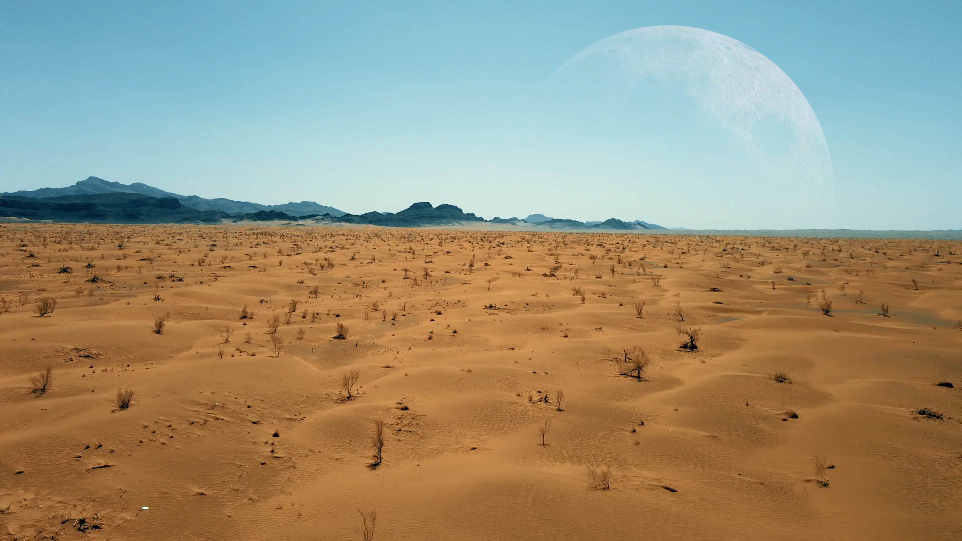
2.阻礙
Notes:
https://pixabay.com/videos/desert-moon-mountain-nature-88660/

Slide 4

3.努力
Notes:
https://pixabay.com/videos/running-people-sports-run-walk-294/

Slide 5

4.結果
Notes:
https://pixabay.com/videos/woman-meditation-wellness-184538/

Slide 6
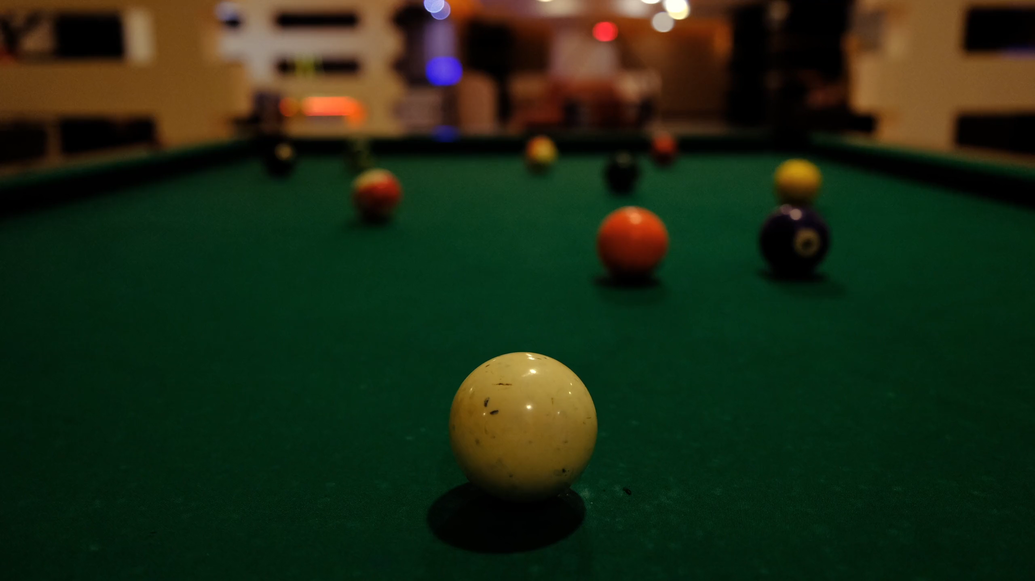
5.意外
Notes:
https://pixabay.com/videos/billiards-the-game-ball-122511/

Slide 7
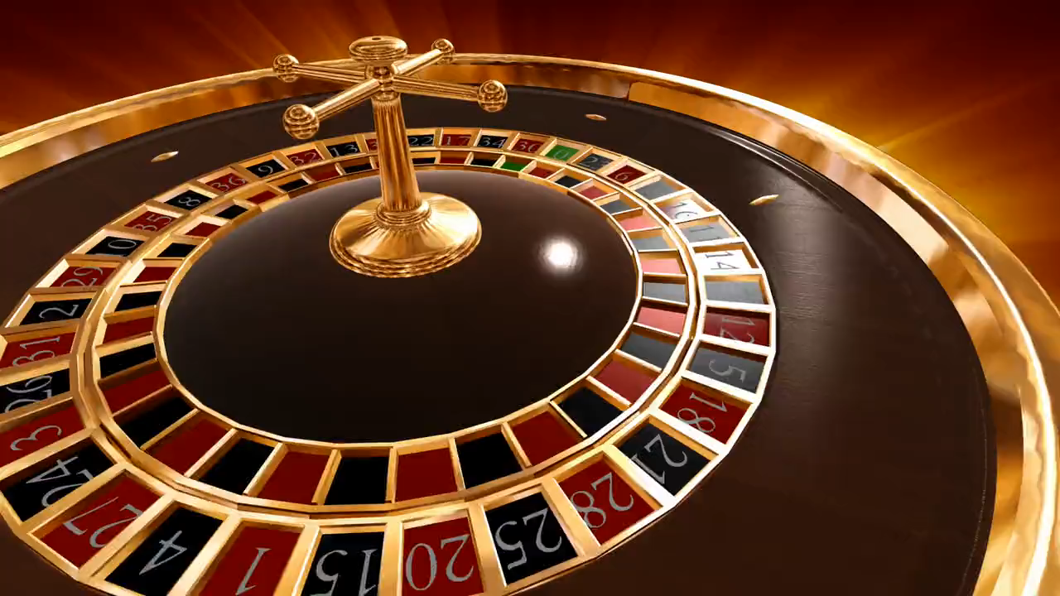
6.轉彎
Notes:
https://pixabay.com/videos/roulette-casino-game-gambling-54607/

Slide 8

7.結局
Notes:
https://pixabay.com/videos/children-kids-boys-friends-happy-74540/

